Slide 1


Slide 2
Project :
Exploratory Data Analysis with Seaborn

Slide 3
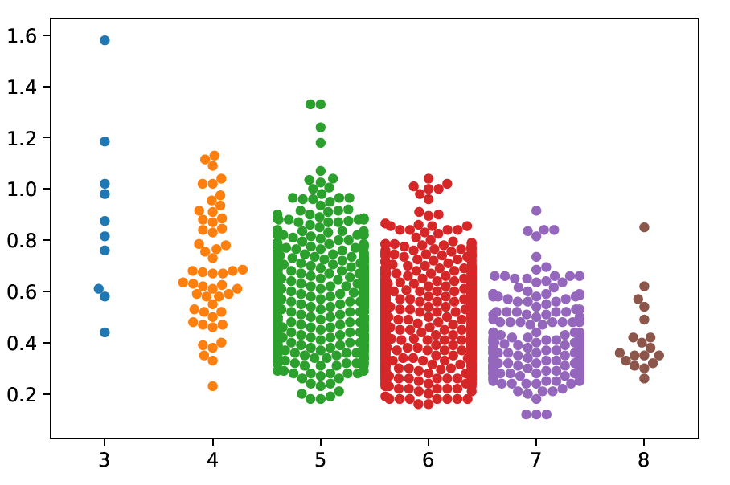
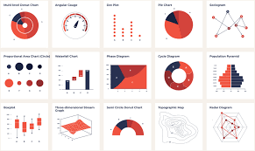
EDA ?
Exploratory data analysis is an approach to analyzing data sets to summarize their main characteristics, often with visual methods.

Slide 4
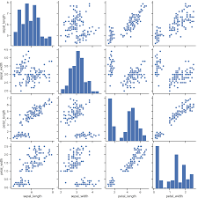
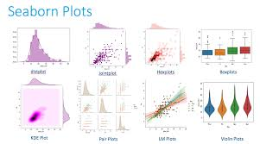
Seaborn ?
Seaborn is a Python data visualization library based on matplotlib. It provides a high-level interface for drawing attractive and informative statistical graphics

Slide 5
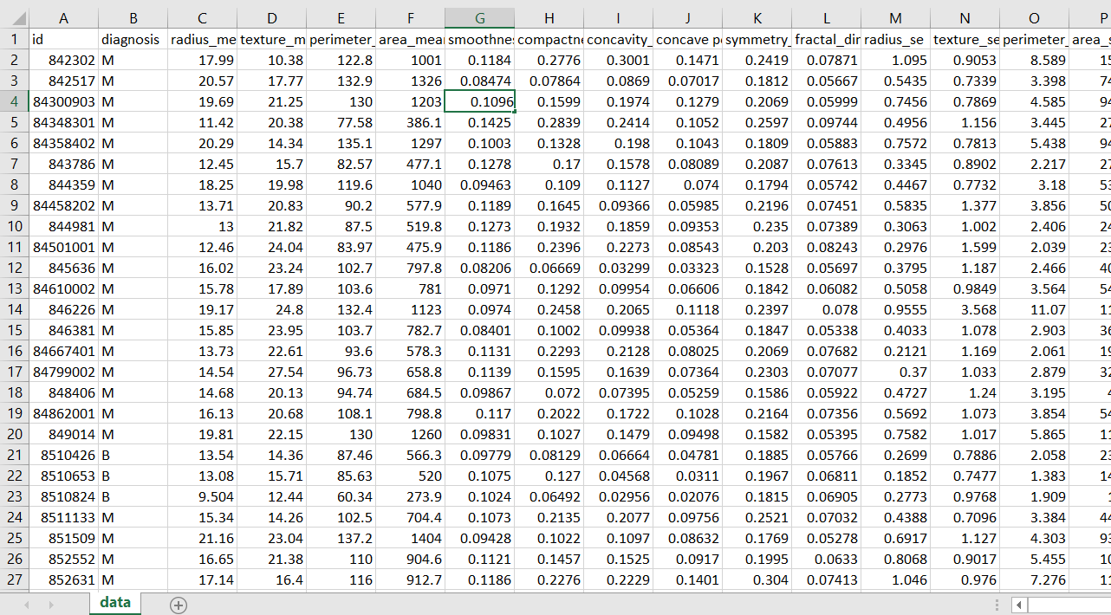
Dataset :
Data set I have used is the Benign and Malignant Tumour dataset

Slide 6
Explanation :

